Slide 1

COURSE 1 – EXCEL FINAL ASSESSMENT
HRITHIK S
EMP ID : 4364
ILMS USERNAME : LVADSUSR156

Slide 2
CASE STUDY: WORK DATA SET ANSWER 1 - 10

Slide 3

1. AVERAGE LEAD TIME BETWEEN REQ DATE AND COMPLETION DATE
At first, filter the data which have been completed by removing the blanks from workDate column.
The average lead time between reqDate and workDate can be found by finding the difference between workDate and reqDate.
After finding the difference between two dates we can find the average days taken to complete by using the formula
=AVERAGE(Y:Y)
The average lead time taken to complete all work orders is 28.016 Days

Slide 4
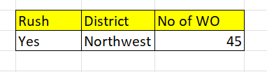
2. DISTRICT WITH HIGHEST NUMBER OF RUSH ORDERS
By Using Pivot Table, we can categorize the date by filtering the Rush Column as “YES” and after sub-categorize the district names and finding the total number of work orders by counting the orders.
After that we found that Northwest District has the highest number of Rush work orders of 45 Orders.

Slide 5
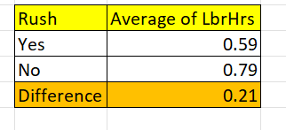
3. DIFFERENCE OF AVERAGE LABOUR HRS BETWEEN RUSH AND NON-RUSH JOB
By using Pivot Table, we can find the average of labour hrs based on the rush and non rush jobs.
After finding the average for both we found that the
Rush Jobs holds an average of 0.59 hrs and non – rush job holds an average of 0.79 hrs and the difference between them is about 0.21 hrs.
By this we can conclude that Rush jobs takes less labour hrs and it is faster than non – rush Jobs.

Slide 6
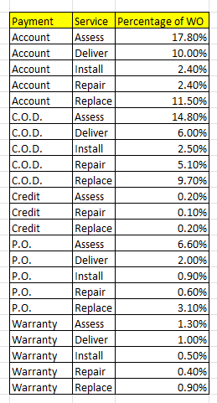
4. DISTRIBUTION OF PAYMENT TYPES ACROSS DIFFERENT SERVICES
The Distribution of the payment types across difference services can be found by using pivot table and categorizing the payment and services to get the percentage of orders taken by each services based on the payment types.

Slide 7
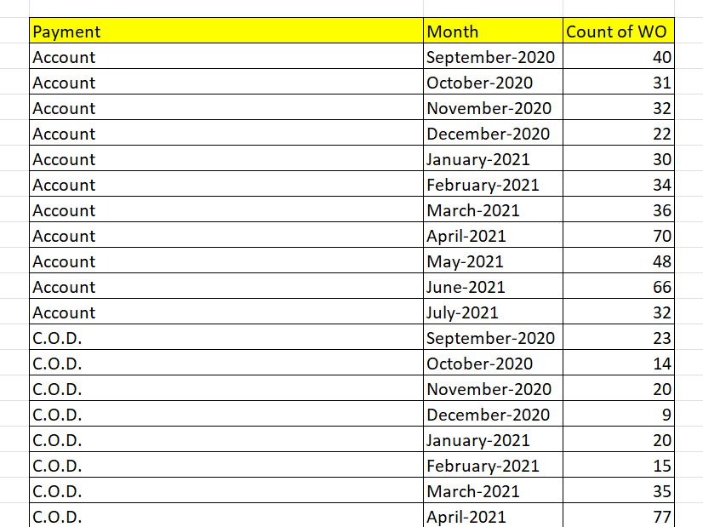
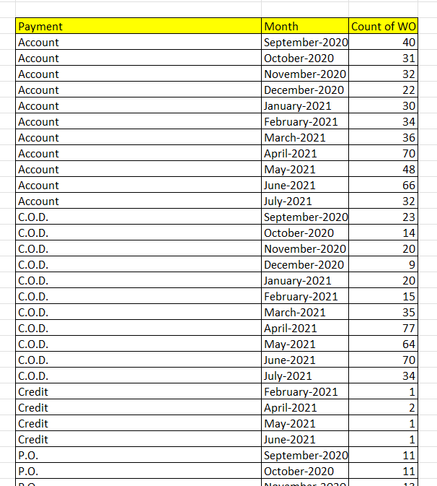
5. TRENDS IN THE DISTRIBUTION OF PAYMENT TYPES OVER THE TIME
Over the times, the data shows that the trends varies between the months and there is an increased number of work orders recently across all payment types.
The trend was found with the help of pivot table and pivot chart using the payment types, month-year and number of orders.

Slide 8
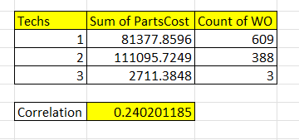
6. RELATIONSHIP BETWEEN TECHNICIAN REQUIRED AND COST OF PARTS
No, there is no relationship between the number of technicians required and cost of parts.
The relationship can be found by using the correlation of the techs and partCosts
=Correl(techcolumn:partsCost)

Slide 9
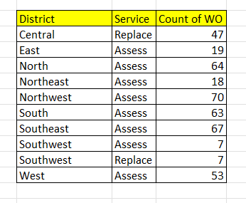
7. MOST COMMON TYPE OF SERVICE REQUESTED IN EACH DISTRICT
It can be found with the help of pivot table and we can find the most common service type across Districts with the number of orders and by finding the maximum among them.
By this, we can say that ACCESS is the most common service across Districts

Slide 10
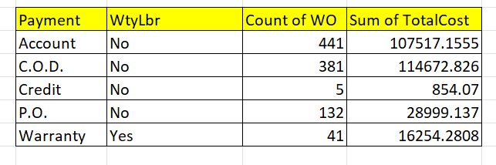
8. DISTRIBUTION OF PAYMENT TYPES WITH WARRANTY LABOUR
We can say that the warranty labours are only applicable for the payment type : Warranty and it is distributed only among the certain payment type.
There are 41 orders among the warranty payment with warranty labour.

Slide 11
DASHBOARD

Slide 12
